Slide 1
Project EDUCATION CONSULTANCY TEAM MEMBERS DaRSHAN SHINDE VELURU PUNEETH KUMAR KALYANA LAKSHMI KESAVAN R SAM ARLIN JEFRY.H MENTOR SURAMYA BISWAS

Slide 2
AGENDA
Introduction
Technology and tools
Modules to be Implemented
Outputs
Future Enhancements
Conclusion

Slide 3

Introduction
The Education Consultancy System aims to support students, parents, and educational institutions in effective educational planning. It facilitates communication between consultants and stakeholders, enhancing training program development. Key features include user authentication and appointment management. This system leverages technology to promote educational growth and success.

Slide 4
Technology AND TOOLS
#FRONTEND
React JS, HTML, CSS
#BACKEND
Java 17
Spring Boot 3(Spring Data JPA,Spring Security)
#DATABASE
MYSQL 8
#TOOLS & OTHERS
Build Tool:Maven
Web-Server:Tomcat
IDE:Eclipse ,VS Code

Slide 5
MODULES TO BE IMPLEMENTED
User Authentication and Registration
Admin Dashboard
Student Dashboard
Course
Subscription Management
Payment Management

Slide 6
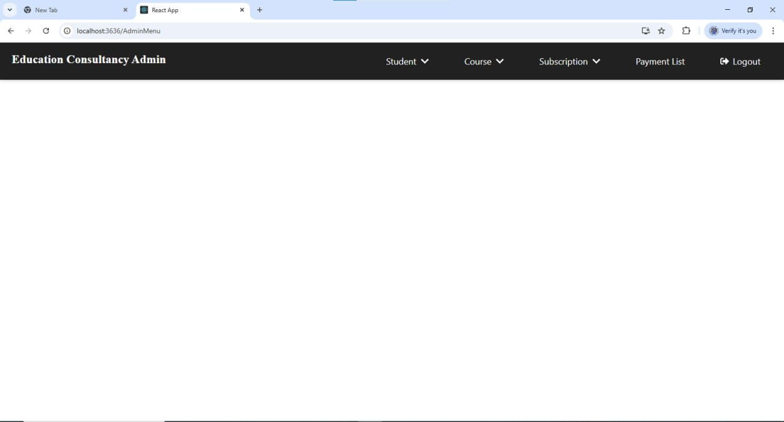
OUTPUT OF Admin Dashboard
This displays an Education Consultancy Admin Menu with options for managing students, courses, subscriptions, payments, and logging out. It serves as a navigation panel for administrative tasks.

Slide 7
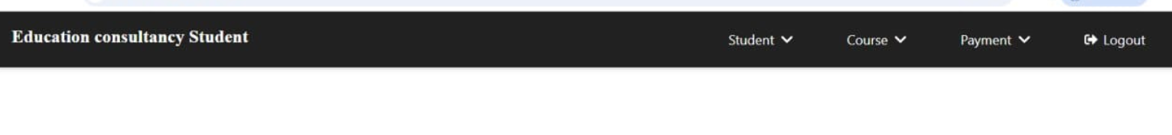
OUTPUT OF STUDENT Dashboard
This is a navigation bar for an education consultancy student portal. It includes menu options such as "Student," "Course," and "Payment," each with dropdown functionality. There is also a "Logout" button for user session management. The design suggests a structured interface for managing student-related activities.

Slide 8
FUTURE ENHANCEMENTS
*Implement an AI-powered chatbot to enhance user experience.
*Develop a mobile app version for on-the-go access.
*Integrate a learning management system to offer online courses.
*Implement data analytics and reporting features for data-driven decisions.

Slide 9
CONCLUSION
The Education Consultancy System provides a comprehensive platform to support educational planning and development. Key modules include user authentication, dashboards, course management, and payment processing. Future enhancements can integrate AI chatbots, mobile apps, learning management, and data analytics to adapt to evolving user needs and enable data-driven decision-making. The system aims to streamline the consultancy process and promote collaboration, accessibility, and growth for all stakeholders.

Slide 10
Thank you

